Slide 1
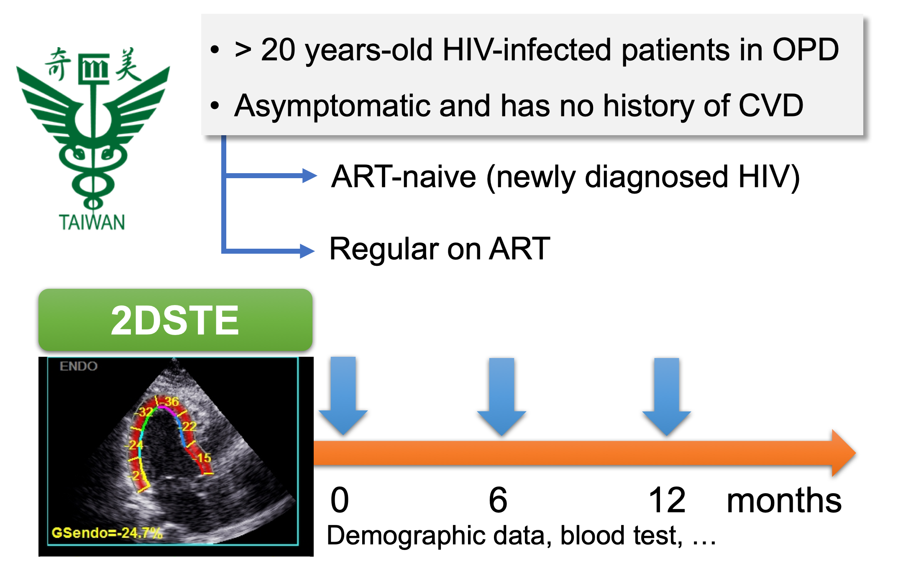
Association of antiretroviral therapy with myocardial deformation in antiretroviral therapy naive HIV-infected patients
PEB0184
Your are welcome to contact with us via our line@ or e-mail (kampungths@ gmail.com).
Han-Siong Toh¹, Chia-Te Liao², Wei-Ting Chang², Hung-Jen Tang^{3,4}, Zhih-Cherng Chen², Yu-Hui Li², Jou-Chen Li², Hui-Chun Ku⁴, Wang-Ping Chen⁴
¹Department of Intensive Care Medicine, ²Department of Cardiology, ³Department of Infectious Diseases, ⁴Infection Control Center, Chimei Medical Center, Tainan, Taiwan
Chi Mei
HIV Care Team
Heart Function
Care Team
Background
Results
HIV infection has been associated with cardiac dysfunction due to multifactorial causes. In our previous study using 2D speckle-tracking echocardiography (2DSTE), we noticed that impaired LV and RV deformation is highly prevalent in asymptomatic HIV-infected patients. Although antiretroviral therapy (ART) can lower the risk of cardiovascular disease (CVD), its effect on the myocardial strain remains unclear. Thus, this study aims to investigate whether myocardial deformation change is reversible after the initiation of ART in ART-naive population.
A total of 20 ART-naive and 132 ART-experienced patients were recruited. Surprisingly, the ART-naive group had a higher prevalence of abnormal LV myocardial deformation, comparing to ART-experienced group (15.0% vs. 6.1%)，despite their younger age and lower incidence of risk factor for CVD (Table 1 & 2). After six months of ART, 125 and 19 patients kept follow-up in the cohort and 2DSTE were repeated. Eight patients dropped out from the cohort and seven was in the ART-experienced group. Five patients were loss follow-up, one patient withdrew from the study, and one patient passed away. The patient dropped out in the ART-naive group was due to personal reason. His LVGLS and RVGLS were within normal range in the first examination
After six months, The prevalence of abnormal LV myocardial deformation for the ART-naive group dropped to 10.5%, while 6.4% of the experienced group had abnormal myocardial deformation. The LVGLS changes of ART-naive and experienced group were -0.9 ± 4.1% and 0.1 ± 3.4% respectively. Regarding RV systolic function, more patients in the ART-experienced are found to have impaired RVGLS. However, its clinical significance is to be determined. On the other hand, there was no significance change in RV systolic pressure.
Table 2. Echocardiographic data of the study population.
Echocardiographic data | ART-Experienced | ART-Naive | ART-Experienced (after 6 months) | ART-Naive (afer 6 months)
Left ventricular (LV) function | N = 132 | N = 20 | N = 125 | N = 19
LV ejection fraction (LVEF %), mean ± SD | 66.2 ± 5.6 | 63.5 ± 4.6 | 66.9 ± 7.5.3 | 65.5 ± 5.3
LV systolic dysfunction (LVEF < 50%), n(%) | 1 (0.8) | 0 | 1 (0.8) | 0
LV diastolic dysfunction (E/A < 0.8), n (%) | 12 (9.1) | 0 | 10 (8.0) | 1 (5.3)
LV hypertrophy (LVMI M > 115 or F > 95), n (%) | 1 (0.8) | 0 | 8 (6.4) | 2 (10.5)
LV GLS (%), mean ± SD | -19.0 ± 2.5 | -17.8 ± 3.0 | -18.1 ± 3.4 | -18.4 ± 2,8
Impaired LV GLS (LVGLS > -15%), n (%) | 8 (6.1) | 3 (15.0) | 8 (6.4) | 2 (10.5)
Right ventricular (RV) function
RV TDI doppler (S’, cm/s), mean ± SD | 14.8 ± 2.2 | 14.7 ± 1.5 | 14.2 ± 2.2 | 14.5 ± 1.4
RV TAPSE (mm), mean ± SD | 22.9 ± 2.9 | 22.2 ± 3.0 | 22.7 ± 2.9 | 23.2 ± 2.1
RV systolic dysfunction (S’<11.5 or TAPSE<16), n (%) | 8 (6.1) | 1 (5) | 11 (8.8) | 1 （5.3)
RV GLS (%), mean ± SD | -19.2 ± 4.4 | -18.8 ± 4.4 | -18.9 ± 4.4 | -18.9 ± 5.2
Impaired RV GLS (RVGLS > -18%), n (%) | 43 (32.6) | 8 (40) | 50 (40.0) | 7 (36.8)
Pulmonary hypertension
RV systolic pressure (mmHg), mean ± SD | 16.8 ± 6.7 | 17.2 ± 4.0 | 18.7 ± 6.6 | 17.5 ± 4.2
Pulmonary hypertension (RVSP > 25mmHg), n (%) | 14 (10.6) | 1(5) | 13 (10.4) | 1 (5.3)
Methods
Table 1. Demographic data of the study population.
Demographic data | ART-naive (n = 20) | ART-experienced (n = 132)
Age, mean ± SD | 28.2 ± 11.5 | 37.4 ± 11.0
Gender (M : F) | 20 : 0 | 124 : 8
BMI (kg/m²), mean ± SD | 20.9 ± 3.4 | 22.7 ± 3.5
Years of HIV diagnosis, median (IQR) | - | 4 (2-6)
Months on ART, median (IQR) | - | 42 (24-69.25)
CD4 count (per mm³), mean ± SD | 403.9 ± 245.1 | 534.6 ± 245.0
CD4 count < 200/mm³, n (%) | 5 (25.0) | 8 (6.1)
Viral load < 200 copies/mm³, n (%) | 0 | 126 (95.5)
History of AIDS, n (%) | 5 (25.0) | 60 (45.5)
Recreational drug used, n (%) | 2 (10.0) | 13 (9.8)
Traditional risk factors of CVD
Hypertension, n (%) | 3 (15.0) | 33 (20.0)
Diabetes mellitus, n (%) | 1 (5.0) | 8 (6.1)
Dyslipidemia, n (%) | 7 (35.0) | 60 (45.5)
Smoking, n (%) | 8 (40.0) | 58 (43.9)
Obesity (BMI ≥ 30) , n (%) | 0 | 5 (3.8)
Family history of CVD, n (%) | 4 (20.0) | 50 (37.9)
This prospective cohort study enrolled asymptomatic ART-naive HIV-infected patients from August 2017 to August 2018 in a medical center of Taiwan. Simultaneously, patients with regular ART were also recruited for comparison. Patients with symptoms or history of acute illness or heart failure were excluded. Medical records, history of HIV infection, risk factors for cardiovascular disease were reviewed. 2DSTE was performed during enrolment and repeated after six months to measure the left ventricular (LV) and right ventricular (RV) myocardial strain. Abnormal LV global longitudinal strain (LVGLS) and RV global longitudinal strain (RVGLS) were defined as greater than -15% and -18% respectively. A greater absolute number of GLS represents better myocardial deformation.
Conclusions
This is the first cohort study applying 2DSTE in Asian HIV-infected population, and to evaluate the effect of ART on myocardial deformation. In our previous study, we demonstrated that impaired LV and RV deformation is highly prevalent in asymptomatic HIV-infected patients despite a preserved LV and RV function derived by the traditional echocardiography. During the follow-up and repeated 2DSTE after six months, this preliminary data showed that myocardial deformation is likely to be reversed after the initiation of ART in naive patients. The result emphasizes the importance of early ART initiation on CVD. However, the long term effect of ART remains a question, and we expected further analysis of this ongoing cohort could provide more evidence on the impact of ART on CVD in the future.
PRESENTED AT THE 23RD INTERNATIONAL AIDS CONFERENCE (AIDS 2020) | 6-10 JULY 2020

